Slide 1
Remembrance

Slide 2
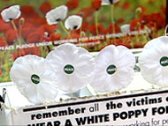
White or Red?
1. Red Poppy =
War as Noble Sacrifice
Soldiers die to secure our freedom
We should be prepared to follow their brave example
Money raised should be used to support injured soldiers and their families
The White Poppy fundraising campaign is disrespectful: it leaves soldiers short of support and suggests the sacrifice of our brave soldiers is pointlessly stupid.
2. White Poppy =
War as Senseless Waste
Soldiers die for greedy governments
We should ensure it never happens again
Money raised should be used to promote international understanding
The Red Poppy fundraising campaign is disrespectful: it turns soldiers into objects of charity and bullies us into accepting that “our” soldiers are always “right”.
3. Would you wear BOTH or do they contradict each other?
4. Would you wear NEITHER, or does this show you’re shallow?

Slide 3
Now choose your group
Red = Mr. Palmer
White = Mr. Fretwell
Both = Mr. Stenson
Neither = Mr. Hunt

Slide 4
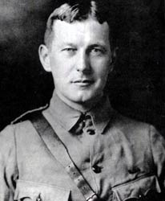
Where would he stand?
In Flanders fields the poppies blow
Between the crosses, row on row,
That mark our place; and in the sky
The larks, still bravely singing, fly
Scarce heard amid the guns below.
We are the Dead.
Short days ago
We lived, felt dawn, saw sunset glow,
Loved and were loved, and now we lie
In Flanders fields.
Take up our quarrel with the foe:
To you from failing hands we throw
The torch; be yours to hold it high.
If ye break faith with us who die
We shall not sleep, though poppies grow
In Flanders fields.
- John McRae

