Slide 1
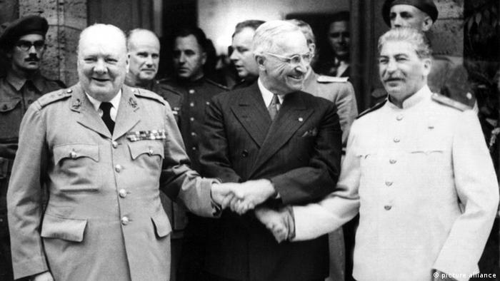
Operation POTSDAM
Jailbreak mission: 1945
By www.activehistory.co.uk

Slide 2
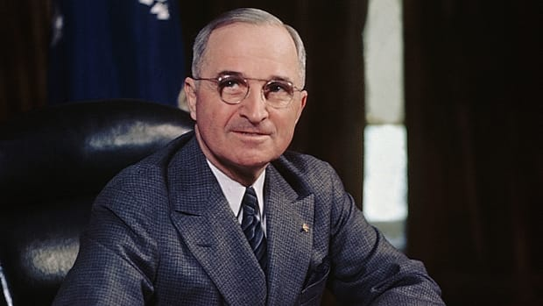
Your mission
It is July 1945. Hitler is dead, Nazi Germany has surrendered, and you are part of President Truman’s American delegation which has arrived at the Potsdam conference just outside of war-torn Berlin. Here, you have been meeting with British Prime Minister Winston Churchill and Soviet premier Josef Stalin to agree upon the shape of the post-war world.
You have discovered that the Soviets have been bugging President Truman’s room, which is a massive security breach that will compromise his negotiating position.
Unfortunately your conference room was bugged too and you have been locked inside it by the Soviet delegation so that they can continue to listen to Truman’s top-secret meeting which starts in 40 minutes…
You must find a way to unlock the door to warn Truman and prevent the Soviets thwarting his objectives!
The location of the key is inside the box at the center of the room
Now listen carefully to what follows to find out how to crack the code for freedom!

Slide 3
HOW TO ESCAPE: WORK AS A TEAM!
Find a mission: The class needs to locate the 10 “missions” hidden around the room which are written on pieces of paper. Whenever one is found, the teacher halts the class and reads out the mission. It is up to the class to decide who should complete this mission and who should carry on looking for the remaining mission slips.
Complete the mission: Each time students feel a 'mission' is completed, they should alert the teacher. The teacher asks all students to pay attention as the mission is read out and the answer provided. If the answer is correct, the next piece of the timeline (starting with the earliest) is then read out and given to the class on a slip of paper. If the answer is correct, the next piece of the timeline (starting with the earliest) is then read out and ALL STUDENTS SHOULD TAKE NOTES (the importance of this is clear from the “Final Mission”…). If it is wrong, the class has to “freeze” for 60 (valuable) seconds as a penalty.
Escape the room: Once the class has the final piece of the timeline, a clue is provided which enables you to solve the final mission and “escape” (see next slide…!)

Slide 4
The final mission
Once you have got the full timeline of 10 events, all students will stand around the edge of the room. The teacher will read out an event.
The date of this event will unlock ONE of the padlocks.
One student ONLY will be nominated to try unlocking a padlock with this clue (they can try as many times and for as many padlocks as they like).
They have 30 seconds to try unlocking a padlock without any help from the rest of the class.
If they fail to do so then we have to wait in silence for one minute till the next person is chosen to try again. All locks need to be unlocked to reveal the final piece of the puzzle!

Slide 5
The final mission
Once you have got the full timeline of 10 events, four questions will be privately given on slips of paper to different individuals or pairs of students in the class.
The answer to each clue will be in the form of a digit (0-9).
Each answer will be written on paper and passed back to the teacher.
Once these answers have all been provided, they will complete a phone number.
Once you have decoded the number, you should ring it.
You will be asked three security questions to test your knowledge of Cuban affairs.
If you answer all three successfully, you will be rescued.
If not, the phone will be put down and it will not be answered again for another five minutes: at which point three fresh questions may be asked…

